Slide 1
Testing the influence of autonomous system input on human perceptual categorization of speech
TECHLAV Seminar Series
Joseph D. W. Stephens, Ph.D.
Associate Professor
Psychology Department
North Carolina A&T State University
JDW Stephens Influence of autonomy on perception 25 September 2015 1

Slide 2
Overview
The importance of Situation Awareness (SA)
SA with large-scale autonomous systems
The question of uncertainty
Pilot study: Testing the influence of uncertain info.
Future directions
JDW Stephens Influence of autonomy on perception 25 September 2015 2

Slide 3
Overview
The importance of Situation Awareness (SA)
SA with large-scale autonomous systems
The question of uncertainty
Pilot study: Testing the influence of uncertain info.
Future directions
JDW Stephens Influence of autonomy on perception 25 September 2015 3

Slide 4


The importance of Situation Awareness
What is Situation Awareness?
Endsley’s framework (e.g., Endsley, 1995):
Level 1 - Perception of elements in environment
Level 2 - Comprehension of current situation
Level 3 - Projection of future status
Importance of Level 1 is not to be underestimated
JDW Stephens Influence of autonomy on perception 25 September 2015 4

Slide 5
Overview
The importance of Situation Awareness (SA)
SA with large-scale autonomous systems
The question of uncertainty
Pilot study: Testing the influence of uncertain info.
Future directions
JDW Stephens Influence of autonomy on perception 25 September 2015 5

Slide 6
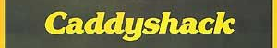

SA with large-scale autonomous systems
Let’s consider a light-hearted scenario…
Note: This film is being used for illustrative purposes and its use should not be construed as an endorsement!
JDW Stephens Influence of autonomy on perception 25 September 2015 6

Slide 7

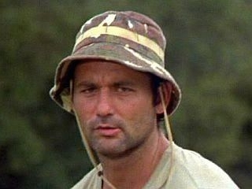
SA with large-scale autonomous systems
Carl Spackler wants to know where the gophers are
… but it’s a big golf course
?
JDW Stephens Influence of autonomy on perception 25 September 2015 7

Slide 8


SA with large-scale autonomous systems
What if Carl had a system of robots?
…could assist SA
Note that there is
automation
involved in ID
JDW Stephens Influence of autonomy on perception 25 September 2015 8

Slide 9
Overview
The importance of Situation Awareness (SA)
SA with large-scale autonomous systems
The question of uncertainty
Pilot study: Testing the influence of uncertain info.
Future directions
JDW Stephens Influence of autonomy on perception 25 September 2015 9

Slide 10
The question of uncertainty
What if the automation is wrong?
JDW Stephens Influence of autonomy on perception 25 September 2015 10

Slide 11

The question of uncertainty
What if the automation is wrong?
False Alarm: Not actually a gopher
JDW Stephens Influence of autonomy on perception 25 September 2015 11

Slide 12
The question of uncertainty
What if the automation is wrong?
Miss: An undetected gopher
JDW Stephens Influence of autonomy on perception 25 September 2015 12

Slide 13
The question of uncertainty
Errors (i.e. false alarms, misses) can potentially negate the benefits of automation (Wickens & Dixon, 2007)
However, potential for errors cannot be eliminated
In dynamic environment, always some uncertainty
Current research question: How can human operators interpret information about the uncertainty?
Goal: maximize accuracy in Level 1 SA
JDW Stephens Influence of autonomy on perception 25 September 2015 13

Slide 14


The question of uncertainty
How does Carl’s SA change
if the system tells him
about its own
uncertainty?
90%
50%
70%
80%
JDW Stephens Influence of autonomy on perception 25 September 2015 14

Slide 15
Overview
The importance of Situation Awareness (SA)
SA with large-scale autonomous systems
The question of uncertainty
Pilot study: Testing the influence of uncertain info.
Future directions
JDW Stephens Influence of autonomy on perception 25 September 2015 15

Slide 16
Pilot Study
As a first step, we are adding uncertain information to a basic categorization task:
Consonant identification
“Indicate whether you heard ABA or ADA”
Can be influenced by visual information from the face of a speaker (e.g., McGurk & MacDonald, 1976)
Can also be influenced by artificial visual cues (Stephens & Holt, 2010)
What if a computer provides information about the probability of each consonant?
JDW Stephens Influence of autonomy on perception 25 September 2015 16

Slide 17
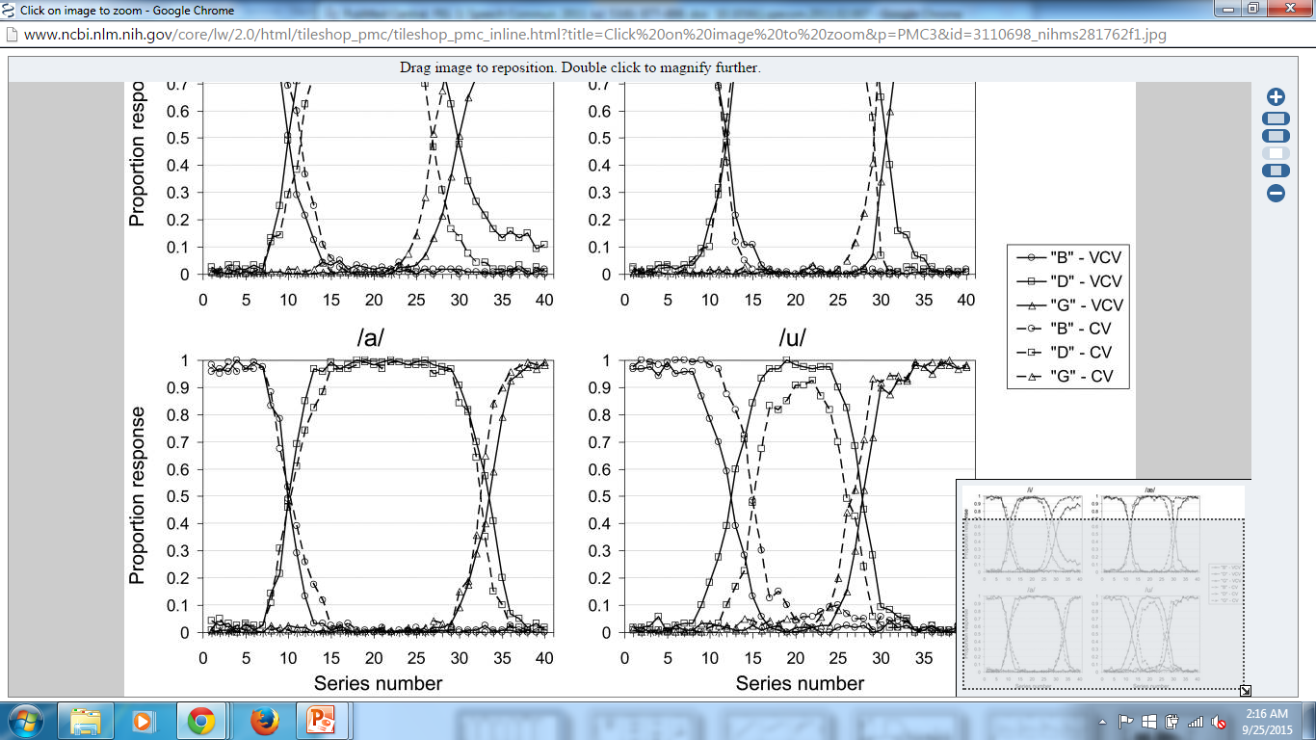

Pilot Study
Stimuli: Five utterances along a series ranging from /aba/ to /ada/ (From the set created by Stephens & Holt, 2011)
JDW Stephens Influence of autonomy on perception 25 September 2015 17

Slide 18
Pilot Study
Uncertain information presented on screen
“The automated system estimates…”
10% ABA; 90% ADA
30% ABA; 70% ADA
50% ABA; 50% ADA
70% ABA; 30% ADA
90% ABA; 10% ADA
XX% ABA; XX% ADA (no information condition)
Intermediate sounds were paired with multiple percentages; each combination occurred 15 times
JDW Stephens Influence of autonomy on perception 25 September 2015 18

Slide 19
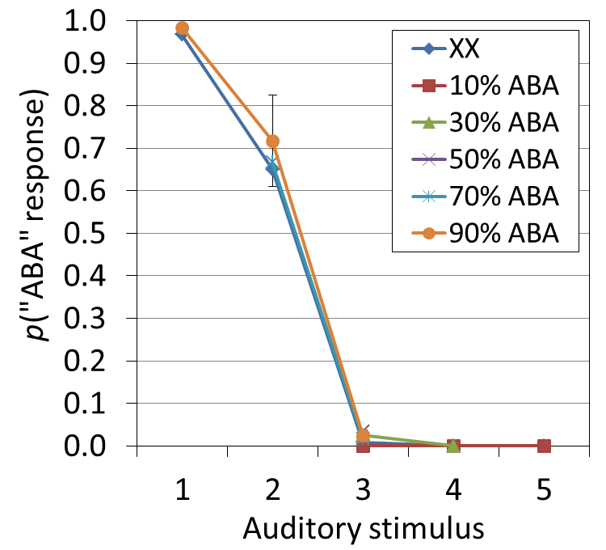
Pilot Study
Preliminary results from n=8 participants
No influence of on-screen percentages
JDW Stephens Influence of autonomy on perception 25 September 2015 19

Slide 20
Overview
The importance of Situation Awareness (SA)
SA with large-scale autonomous systems
The question of uncertainty
Pilot study: Testing the influence of uncertain info.
Future directions
JDW Stephens Influence of autonomy on perception 25 September 2015 20

Slide 21
Future directions
Speech categories are extremely familiar
Little need to rely on automated system
Next experiments will use less familiar categories
Explicitly labeled percentages may be ineffective as cues for perception
Further experiments will represent uncertain information using other types of visualizations for uncertainty
Eventual goal: more realistic SA tasks
JDW Stephens Influence of autonomy on perception 25 September 2015 21

Slide 22
Acknowledgments
Christopher Moody
TECHLAV
NC A&T Psychology Department
JDW Stephens Influence of autonomy on perception 25 September 2015 22

